Slide 1
Instructions for Use
Optiv has developed this PowerPoint as a training resource for cybersecurity awareness.
The content is designed to educate your employees about key behaviors and best practices to combat cybersecurity risks
Consider customizing the suggested scripts on various slides to align with your organization's policies
Additionally, consider customizing the text/imagery in the email examples and replace email signatures and email addresses to match your organization
For more information on Optiv’s Cybersecurity Education services, contact your Optiv account manager, visit https://www.optiv.com/services/strategy/cyber-education or email CybersecurityEducation@optiv.com.

Slide 2


Cybersecurity
Awareness Training
Proprietary and CONFIDENTIAL. Do Not Distribute. © 2025 Optiv Security Inc. All Rights Reserved.

Slide 3

Cybersecurity Awareness
Goal: Take easy, actionable steps to increase online safety,
protect personal data and secure our world.
37%
39%
Intimidated
How do I stay secure online?
Frustrated
It is difficult to stay secure online.
Source: Oh, Behave!: The Annual Cybersecurity Attitudes and Behaviors Report, The National Cybersecurity Alliance, 2023
Proprietary and CONFIDENTIAL. Do Not Distribute. © 2025 Optiv Security Inc. All Rights Reserved.
Notes:
Suggested Script:
Last year, 37% of respondents in a study reported feeling that information on how to stay secure online is intimidating and 39% felt frustrated while trying to stay secure online.
The goal of this presentation and the goal of Cybersecurity Awareness Month is to inform you of easy yet actionable steps to increase online safety. In turn, we aim to alleviate some of the intimidation and frustration that many experience.

Slide 4

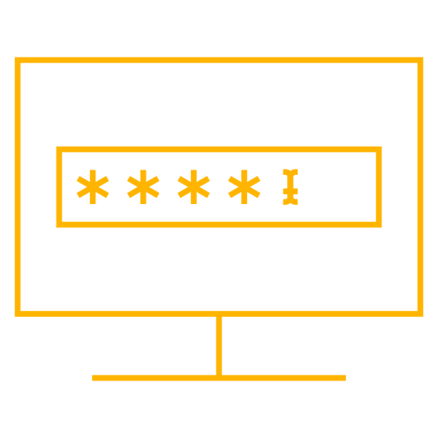
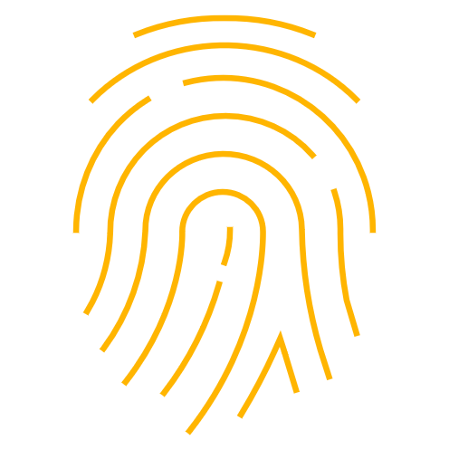
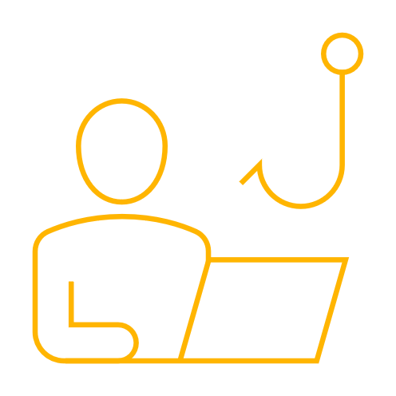

Using strong passwords
Enabling multi-factor authentication (MFA)
Our Focus
Recognizing and reporting phishing
Updating software
Notes:
Suggested Script:
Starting in 2023, Secure Our World is the enduring theme for all future Cybersecurity Awareness Months. This theme concentrates on four fundamental actions.
They are:
Using strong passwords
Enabling multi-factor authentication
Recognize and reporting phishing
Updating software

Slide 5
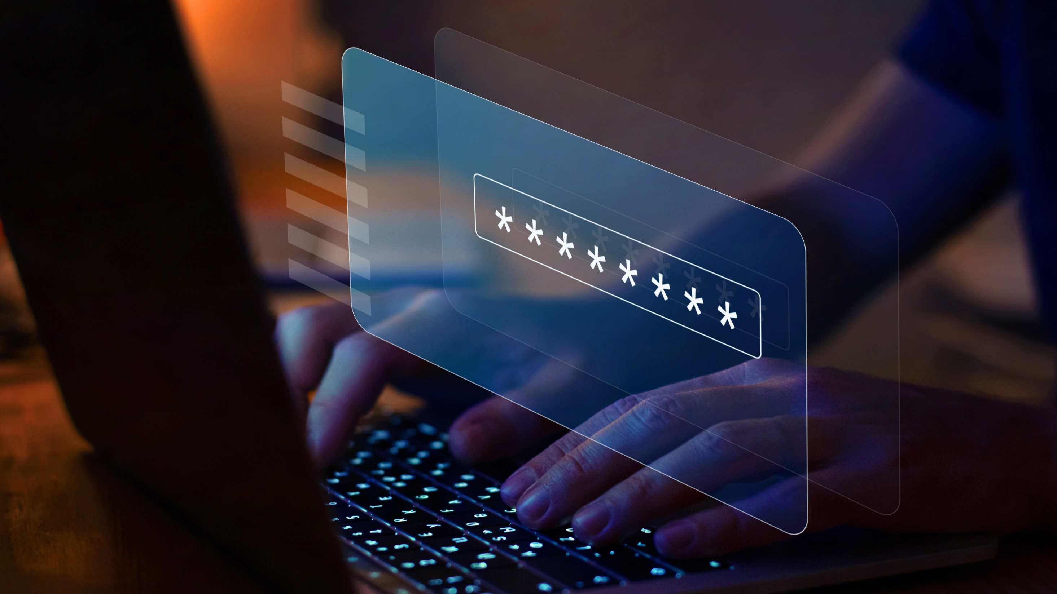
Using Strong Passwords
Key Behavior #1
Proprietary and CONFIDENTIAL. Do Not Distribute. © 2025 Optiv Security Inc. All Rights Reserved.
Notes:
Suggested Script:
Our first key behavior is using strong passwords. Strong passwords is one of the most fundamental steps to securing your online activity.

Slide 6
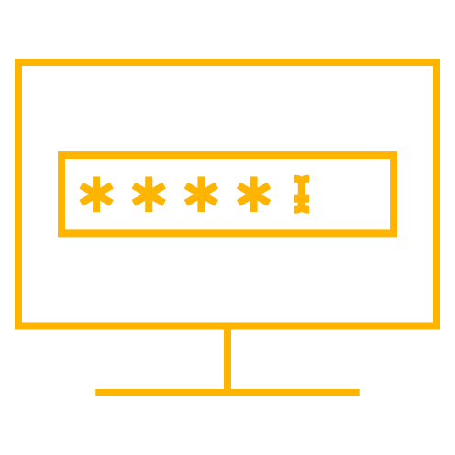
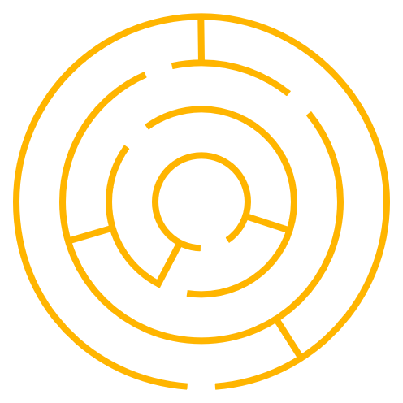

Passwords: Keys to Your Digital Castle
Long
At least 16 characters
in length
Random
Combination of
character types
Unique
Never reuse passwords
Notes:
Suggested Script:
Passwords are the keys to your digital castle. Just like your house, car and office keys, you want to do everything in your power to keep them safe.
Regardless of the account you are protecting, the password you create should be long, random, unique and complex.
First, each one of your passwords should be at least 16 characters in length. The longer the password, the better.
Next, use either random string of mixed-case letters, numbers and special characters OR create a memorable passphrase of 4-7 random words. This will make it even more difficult for hackers to crack with the technologies they use.
Finally, each one of your accounts should be protected with a unique password. If one of your passwords is compromised by a threat actor, you want to prevent them from copying that key and accessing the rest of your digital properties.
Do note that people often will use the same base password and change one or two characters. Having variant passwords like this that are similar in length and strength are not hard to crack if a threat actor cracks one of them. This is why it is important to make each password unique.

Slide 7

The 20 most common
passwords can be cracked by cybercriminals in under one second.
Source: NordPass, Top 200 Most Common Passwords, 2024
Proprietary and CONFIDENTIAL. Do Not Distribute. © 2025 Optiv Security Inc. All Rights Reserved.
Notes:
Suggested Script:
Last year, 37% of respondents in a study reported feeling that information on how to stay secure online is intimidating and 39% felt frustrated while trying to stay secure online.
The goal of this presentation and the goal of Cybersecurity Awareness Month is to inform you of easy yet actionable steps to increase online safety. In turn, we aim to alleviate some of the intimidation and frustration that many experience.

Slide 8
The 10 Most Commonly Used Passwords
123456
123456789
12345678
password
qwerty123
qwerty1
111111
12345
w3d435
123123
Source: NordPass, Top 200 Most Common Passwords, 2024
Notes:
Suggested Script:
Shown here are the 20 most common passwords of 2024.
What do you notice about these passwords? What sticks out to you?
[Options for Participation]
(In-person Session) Would anyone like to share their observations?
(Online Session) Drop your observations in the chat.
(After sufficient wait time of 7-10 seconds, continue.)
Using these keys would not be considered a secure practice because they lack length and complexity.

Slide 9
Creating Long and Complex Passwords
Begin With a Long Phrase
(at least 12 characters)
Integrate Varying Capitalization
Add Symbols
Add Numbers
Mary had a little lamb
Singing in the rain
Make a difference
Basking in the sun
Memorize this
maryHaDalittleLAMB
siNgingIntHerAiN
MakEadiFfereNcE
bAskIngiNtHesUn
meMoRizEthIs
maryH@Dalittle(LAMB)
&iNg!ngIn+HerAiN
M@kEadiFfereN<E
bA$kIng!ntHesUn
m#MoRizEthI&
maryH@Dalittl3(LAM8)
&iN9!ngIn+h3rA|n
M@kE4d1Ff3reN<E
8A$kIng!NtHe5Un
M#M0R1zEthI&
Notes:
Suggested Script:
Creating long and complex passwords can be done in four easy steps.
Take a look at the phrases we have chosen as examples. All of them are at least 12 characters long and do not include any personal information such as birthdates, addresses or names of relative significance.
(Click to bring up the second column.)
Next, let’s integrate some varying capitalization to our phrases.
(Click to bring up the third column.)
After we’ve done that, let’s replace some characters with symbols or add them to our phrase.
(Click to bring up the last column.)
Finally, replace a character or two with numbers or add them to your strengthening password.
Just like that, we turned everyday phrases into long and complex passwords.
You may be concerned that memorizing these passwords will be difficult – especially since each account will have a unique password.

Slide 10
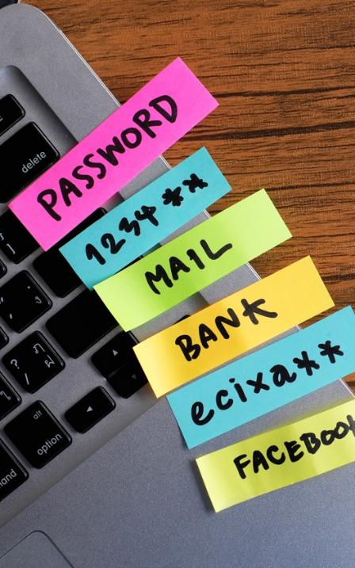
Password Managers
Digitally-Secured Key Ring
Empower an increased security posture
Use encryption for all stored passwords
Require MFA
Alert you to password compromise
Notes:
Suggested Script:
Remembering all you strong passwords can be a challenge. A password manager is software that can help manage your passwords. Not only do password managers store your passwords, but they can also suggest long, random and unique passwords for each of your accounts.
One of the difficulties of our digital age is ensuring that we have appropriately secured all of our online accounts, which may be upwards of 100 or more. Taking away the effort of creating and remembering all of those passwords is alleviated with password managers.
While many users may be hesitant to use password managers, thinking a breach would provide a threat actor access to all their passwords, the best password managers use multi-factor authentication (MFA) and technology that stores the master password in a way that even the provider has no knowledge of the actual password.
Managing passwords with a password manager does give your memory or sticky notes a break and using one can also provide other benefits, depending on which one you choose. These include saving time, working across all operating systems, protecting your identity, notifying you of potentially malicious sites known for phishing and alerting you to potential password compromise.

Slide 11

It Takes Less Than a Second…
…to crack a weak password
…to ruin a reputation
…for an account to be compromised
Check out our resources to learn more about passwords:
https://www.optiv.com/insights/discover/downloads/password-cracking-chart
https://www.optiv.com/insights/discover/blog/secure-your-password
Notes:
Suggested Script:
When it comes to password security, the small details matter. It takes no time at all for a threat actor to crack a weak password, compromise your account or ruin your reputation. Be sure you use lengthy, random and unique passwords for each you have and use a password manager to keep track of them, if allowed by your organization.

Slide 12
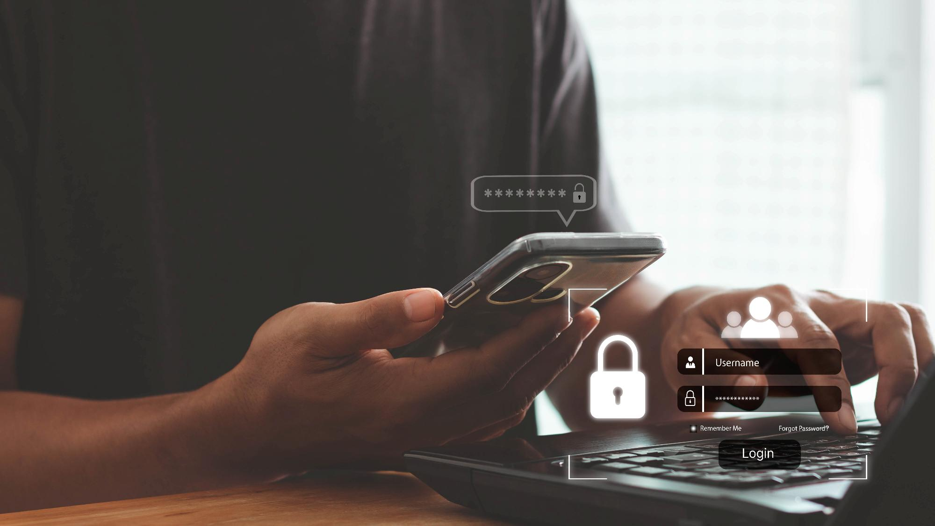
Enabling Multi-Factor Authentication
Key Behavior #2
Proprietary and CONFIDENTIAL. Do Not Distribute. © 2025 Optiv Security Inc. All Rights Reserved.
Notes:
Suggested Script:
Our second topic is enabling multi-factor authentication, or “MFA” for short. This key behavior adds an additional layer of security, preventing unauthorized access to your accounts, even if your secure password has been compromised.

Slide 13

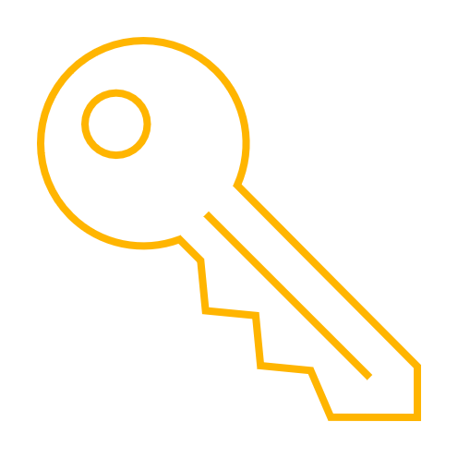

Something You Know
Password
PIN
Passcode
Pattern
Something You Have
Authentication code via text/email/phone/token
Verification request from a mobile app
USB plugged into the device attempting to access the account
Smart card or keys
Something You Are
Fingerprint scan
Facial recognition
Retina scan
Voice verification
Notes:
Suggested Script:
The additional layer of security is often something you have (like a smartphone) or something you are (like a fingerprint) in addition to something you know (which is your long, random and unique password).
Why is it important to enable multi-factor authentication?
[Options for Participation]
(In-person Session) Would anyone like to share?
(Online Session) Drop your ideas in the chat.
(After sufficient wait time of 7-10 seconds, continue to the next slide.)

Slide 14

16 Billion
passwords exposed by hackers in June 2025.
Forbes, Silent Breach Exposes 16 Billion Passwords: 5 Things You Must Do Now, 2025
Proprietary and CONFIDENTIAL. Do Not Distribute. © 2025 Optiv Security Inc. All Rights Reserved.
Notes:
Suggested Script:
Since MFA requires at least two forms of authentication, it’s much harder for cybercriminals to gain unauthorized access to your accounts, even if they have compromised your password.
On July 4, 2024, threat actors exposed the world’s largest collection of stolen passwords. When credentials are breached, organizations face a multitude of consequences, such as reduced productivity, declining trust from clients and partners, financial repercussions or the loss of long-term customer loyalty.
With so much at stake, opting into MFA makes sense.

Slide 15
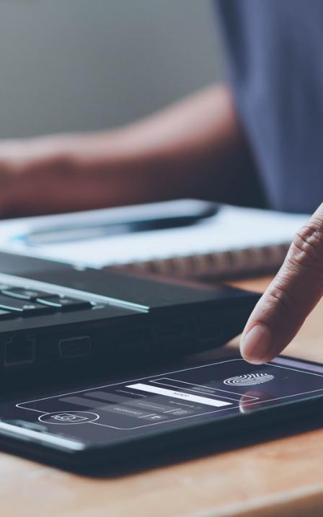
Multi-Factor
99%
Automated bot attacks prevented with SMS code
or on-device prompts
Bulk phishing attempts thwarted by MFA
Difficult, targeted attacks stopped by MFA
Authentication
Success Stories
96%
76%
Source: Evaluating Login Challenges as a Defense Against Account Takeover, Google, 2019
Learn more about MFA:
https://www.optiv.com/cybersecurity-dictionary/2fa-and-mfa
Notes:
Suggested Script:
Consider this. Even if an attacker had possession of one of those 9.94 billion passwords:
100% of automated bot attacks would be prevented if MFA was in place where SMS code or on-device prompts were used as secondary authentication
96% of bulk phishing attempts would be thwarted if MFA was in place
76% of the most sophisticated, difficult-to-stop, targeted attacks would be stopped if MFA was in place

Slide 16
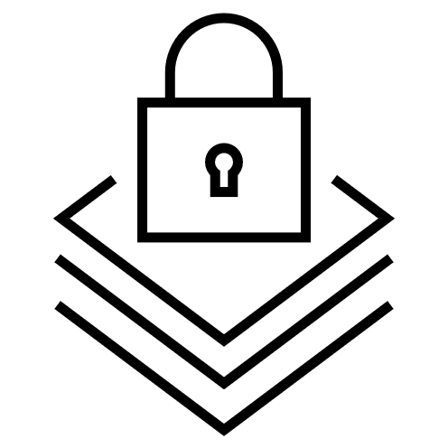


Enabling Multi-Factor Authentication
Tips, Best Practices and Considerations
Availability | Prioritization | Diligence
Not every account or device offers MFA Stay abreast of security updates that may enable the functionality Common types of accounts that offer MFA: Banking/Credit Card Insurance/Medical Email Social Media Stores/Online Shopping | Add a layer of security on accounts with personal information Financial Health Personal Contacts | Continue to use long, random and unique passwords Update your password if you are aware of potential compromise If you receive multiple illegitimate MFA requests: Do not approve requests Contact the service or platform and alert IT immediately Change your password for the account
Source: National Cybersecurity Alliance, StaySafeOnline.org, Multi-Factor Authentication, 2022
Notes:
Suggested Script:
Enabling multi-factor authentication is relatively easy.
First, confirm that MFA is available on your account. If it’s not, keep up-to-date on security updates and feature releases, as more and more accounts are enabling MFA functionality.
Common accounts that enable MFA are often those that contain some type of personal information that you would want protected from threat actors. A second layer of security on accounts that safeguard financial information, personal contacts or connections and health data should be prioritized. These accounts are more valuable to threat actors because they contain data that has potential monetary value or could be used in more sophisticated attacks in the future.

Slide 17
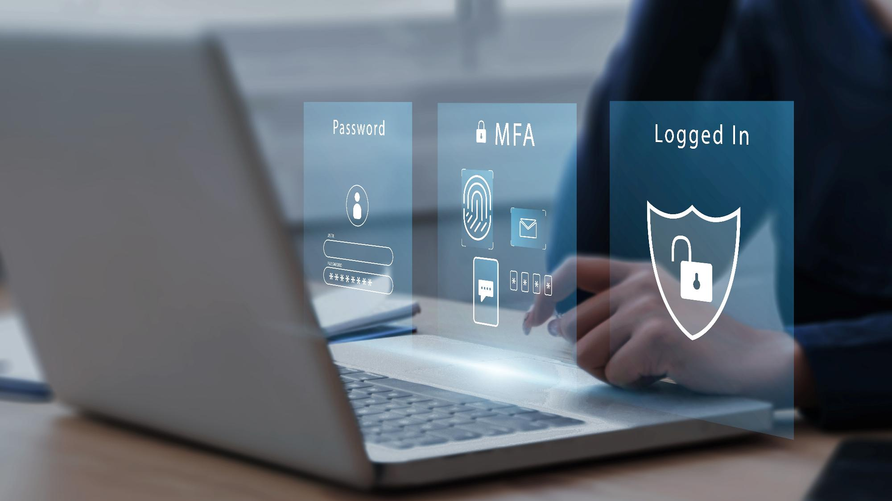
Multi-Factor Authentication Fatigue
Diligence remains top defense against attacks.
Source: Forbes, Hacker Uploads 10 Billion Passwords to Crime Forum - Report, 2024
Proprietary and CONFIDENTIAL. Do Not Distribute. © 2025 Optiv Security Inc. All Rights Reserved.
Notes:
Suggested Script:
As with every security measure, cyber threat actors have attempted to circumvent defenses by capitalizing on MFA fatigue.
Users are accustomed to receiving MFA authentication requests to their email, smartphone or other device. The MFA fatigue attack takes advantage of this by repeatedly pushing authentication requests to users with a goal of coercing them to approve the illegitimate requests.
Often, a preceding social engineering attack has been successful and the attacker has possession of the password for the account protected by MFA.
Remaining diligent and thoroughly analyzing all received communications for authenticity continues to be one of the strongest defenses against social engineering attacks like these.

Slide 18
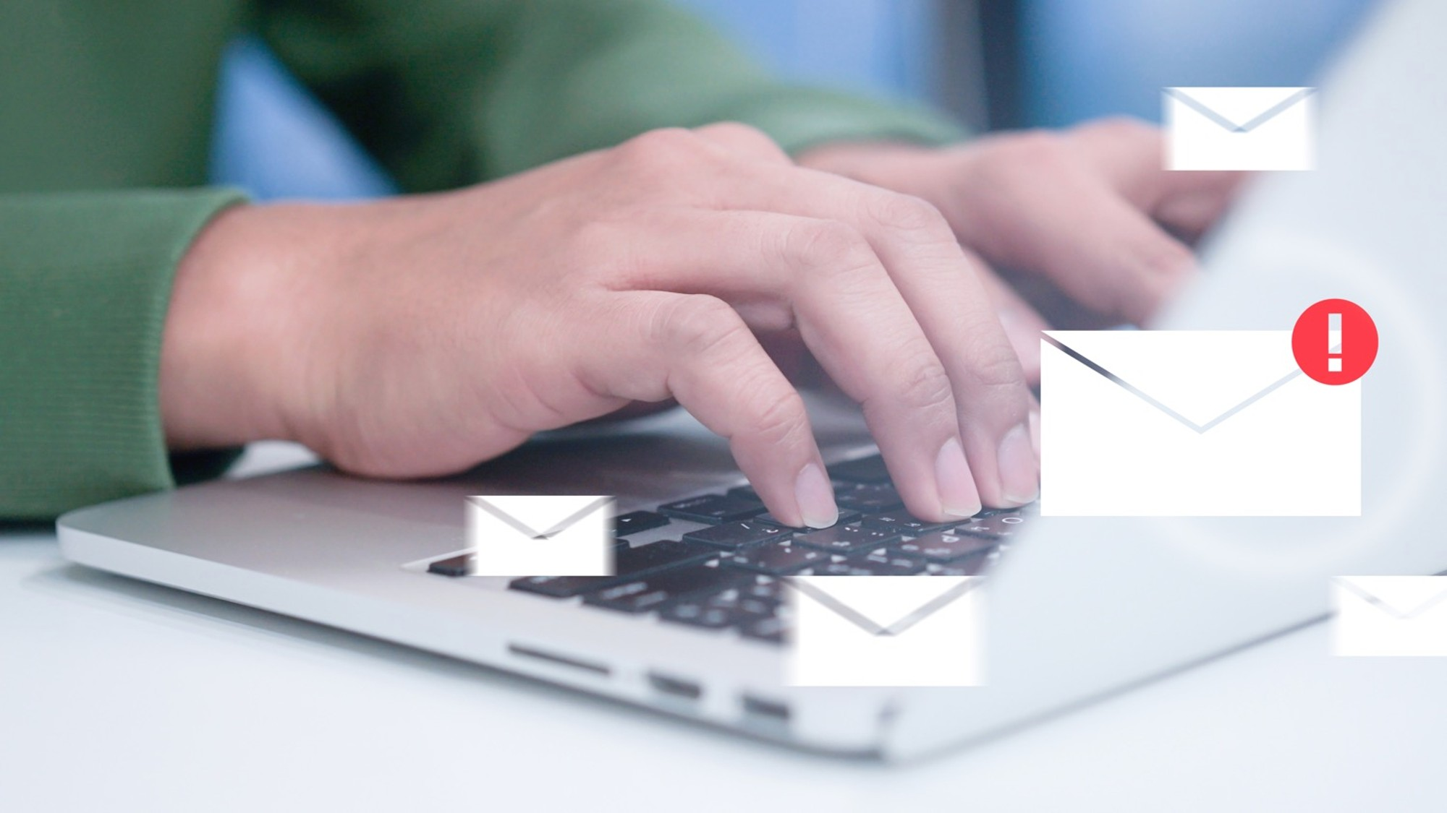
Recognizing and
Reporting Phishing
Key Behavior #3
Proprietary and CONFIDENTIAL. Do Not Distribute. © 2025 Optiv Security Inc. All Rights Reserved.
Notes:
Suggested Script:
Phishing is one of the most common ways cyber threat actors gain access to the valuable information they want.

Slide 19
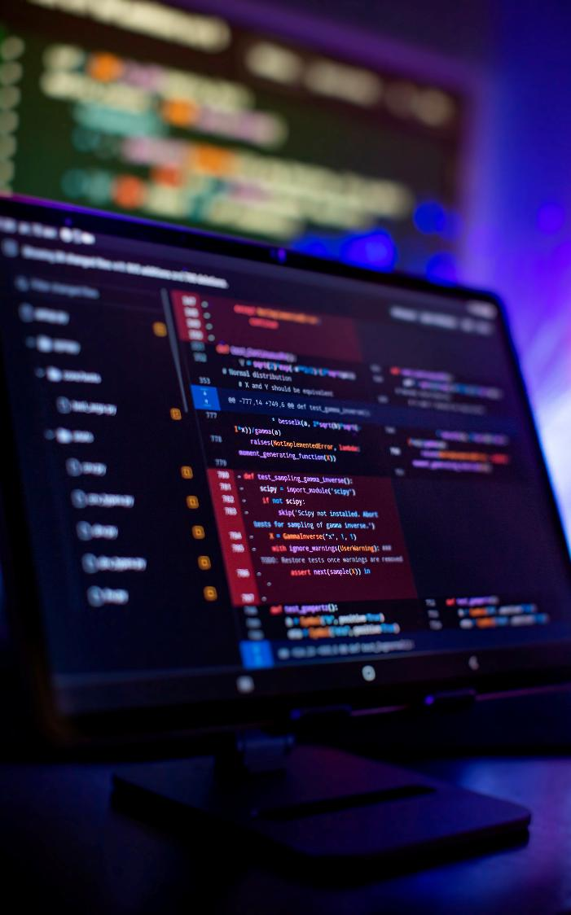

Phishing by
the Numbers
90%
of all cyberattacks begin with phishing
Notes:
Suggested Script:
Consider this. Even if an attacker had possession of one of those 9.94 billion passwords:
100% of automated bot attacks would be prevented if MFA was in place where SMS code or on-device prompts were used as secondary authentication
96% of bulk phishing attempts would be thwarted if MFA was in place
76% of the most sophisticated, difficult-to-stop, targeted attacks would be stopped if MFA was in place

Slide 20
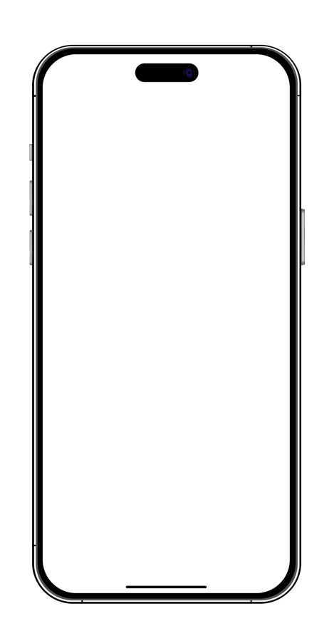




Phishing
Common characteristics of malicious emails
1
Unofficial or unfamiliar sender address
Language intends to urge immediate action
Unusual request for sensitive information
Links that are shortened or mask the destination
Generic greeting
Misspelled words and grammatical errors
Unprofessional or atypical formatting
Action Required: Password Expiration
2
1
From: “Amazon” <info@amazan.com>
Subject: Please update you are account information
Date: August 25, 2023 10:25:12 AM MST
3
Greeting loyal customer,
Our records indicate that your password need to be updated ASAP in order to continue to access you are account.
Please reply with a your existing user name and password so we can confirm your identity or click the link below to be take to a login screen where you can enter your credentials.
Thank you,
Customer care team
<Login Portal>
5
4
2
6
5
3
6
7
7
4
REPLY
FORWARD
Learn more about Phishing:
https://www.optiv.com/cybersecurity-dictionary/phishing
https://www.optiv.com/insights/discover/blog/22-ways-protect-yourself-against-phishing-attacks
Notes:
Suggested Script:
Phishing messages are getting more sophisticated, so thorough scrutiny is necessary when analyzing email. Look for an unofficial or unfamiliar sender addresses, unusual requests for sensitive information, language meant to urge immediate action and links that are shortened or mask the destination.
Formerly common signs like generic greetings, misspelled words, grammatical errors and unprofessional or atypical formatting still exist; however, generative AI has become a useful tool for generating phishing emails free of these telltale signs.

Slide 21
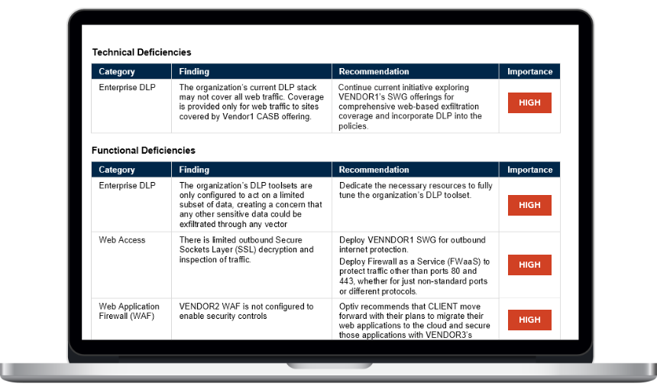
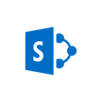
Sophisticated Phishing
You have been invited to a document
From: “SharePoint” <notification@docushare.online>
Subject: You have been invited to a document
Date: August 28, 2024 9:45:12 AM MST
You have been invited to access a resource on SharePoint
Accept or Decline this request.
Requested resource: Click Here
Invited by: Organization – All employees group
REPLY
FORWARD
Notes:
Suggested Script:
As an individual, you may not think you’re a valuable target; however, cybercriminals see you as the gateway to your organization, which could be quite lucrative.
With a little bit of research on your company’s website or on LinkedIn, threat actors can gather enough information to craft a convincing email from SharePoint like the one you see here. If you click on the link to access the file, you'll be taken to what appears to be a standard Office 365 login page. However, it’s not a legitimate website; its purpose is to steal your network credentials – both username and password.
Don’t click links in suspicious emails.

Slide 22

Phishing Attachments
Unsubmitted time notice
From: “Payroll” <payroll@employeecenter.net>
Subject: Unsubmitted time notice
Date: October 25, 2024 2:12:12 PM MST
Hello,
****Payroll has identified you as having an unsubmitted time for week ending 10/6/2023****
Please submit your timesheet to your manager for approval to ensure an accurate paycheck. With the update to timekeeping, please note that you can make necessary corrections to your timesheet yourself.
The timesheet template is attached to this message. Please review it and submit.
Remember the submission deadline is 9:00 a.m. Mondays.
Thank you,
Payroll
REPLY
FORWARD
Notes:
Suggested Script:
Stealing your credentials is not the only way a cybercriminal can gain access to your device and/or your organization’s network. Malicious attachments in phishing emails contain malware that, when downloaded, can allow cybercriminals to take remote control of your computer or capture your keystrokes, among other nefarious activities. Never click attachments in suspicious emails.

Slide 23
Phishing for Replies
Join our disc golf crew!
From: “Teddy” <Teddy@sharecloud.us>
Subject: Join our disc golf crew!
Date: August 25, 2024 1:25:12 AM MST
Hello there!
We’re putting together a disc golf crew to get together after work for some fun and drinks!
If you are interested shoot me a reply with your name and employee ID so I can get you registered for the team!
We play Wednesday afternoons for 5:30 p.m. until we decide to stop.
Looking forward to hearing back from you!
– Teddy
REPLY
FORWARD
Notes:
Suggested Script:
Don’t be fooled by the lack of a link or attachment, though. The phishing email you receive may appear to have an entire backstory with it, involving actual employees within your organization. Don’t reply to suspicious messages.

Slide 24
Coordinated Attack
High-severity alert: Network access elevated
From: “IT Support” <support@employeecenter.net>
Subject: High-severity alert: Network access elevated
Date: May 5, 2024 11:25:12 AM MST
A high-severity alert has been triggered
Network access elevated due to use override
Severity: High
Time: 5/5/2023
Activity: Protection
Details: 1 alert hit on 2cbbd-43nm-09d847388uii, sent by Unknown at time 2022-08-2022 12:21:55.
Due to the severity of this alert, your current network session has been terminated from all corporate systems and resources until resolved. To restore your access to cooperate systems and resources you MUST call the IT department at 1-800-265-5328. Due to the severity of this alert, please DO NOT call the internal IT support helpdesk phone number and DO NOT attempt to resolve this issue yourself.
Thank you,
IT Support
REPLY
FORWARD
Notes:
Suggested Script:
For instance, let’s examine at this email. Unlike the other examples, it’s asking you to make a phone call. You should ask yourself, “Is this a normal process?”
In a coordinated attack, a phishing email is sent that asks the recipient to call a number included in the message. Never call the number in these types of emails. If you want to question the authenticity of the message, find the published number for the entity and call it, not the included number, to question the message.

Slide 25
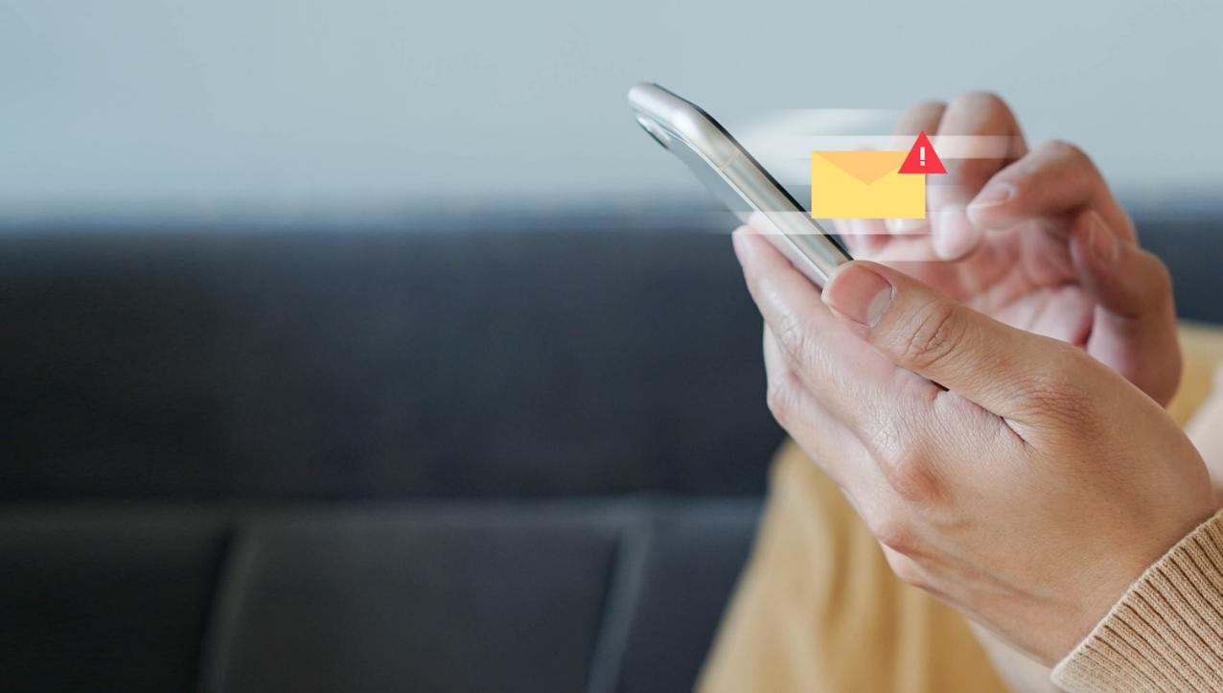
Smishing
Where Phishing Meets Text Messages
Spoofed sender number
Language intends to evoke emotion and
urge immediate action
Source: Forbes, Hacker Uploads 10 Billion Passwords to Crime Forum - Report, 2024
Proprietary and CONFIDENTIAL. Do Not Distribute. © 2025 Optiv Security Inc. All Rights Reserved.
Notes:
Suggested Script:
You may respond to a phishing or smishing attempt differently depending on where you receive the message, but you should always report it first, then delete it. Be sure to follow your organizational policies if you are at work and use best practices at home as well.
Following these best practices could prevent others from falling victim to the same attack, which could help thwart potential cyberattacks.

Slide 26
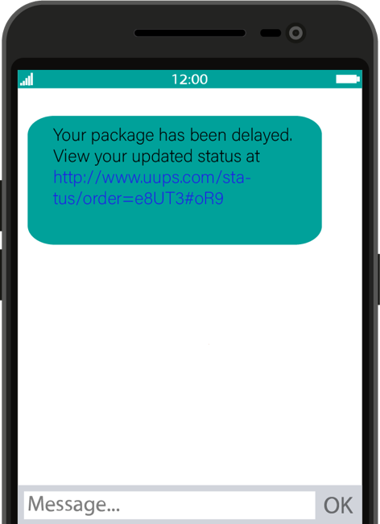
Smishing Examples
Google Security: Changes were recently made to your Google account. Log in to configure your settings.
Amazon: Congratulations. You came 1st in today's Amazon Fitness Watch Raffle! Click the link to arrange delivery:
g3gibhggela;bu8GdYsPhgal360gw
I found this old pic of us! What year was this? http://tinyurl.com/84692tjk
Unusual activity detected in your online banking. Please log in at http://bit.do/dg2Q to secure your account.
Notes:
Suggested Script:
It’s a good idea to ask yourself the following questions when you think you might have received a smishing message like these.
Does this company usually contact me via text?
Can I see the URL linked in the message?
If the smish comes from a company you do business with but not usually via text, manually navigate to the known, official site to verify the information you were sent or call the official, published number of the organization to check out the smish.
You may respond to a phishing or smishing attempt differently depending on where you receive the message, but you should always report it first, then delete it. Be sure to follow your organizational policies if you are at work and use best practices at home as well.
Following these best practices could prevent others from falling victim to the same attack, which could help thwart potential cyberattacks.

Slide 27

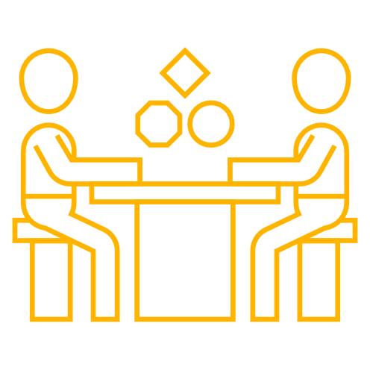
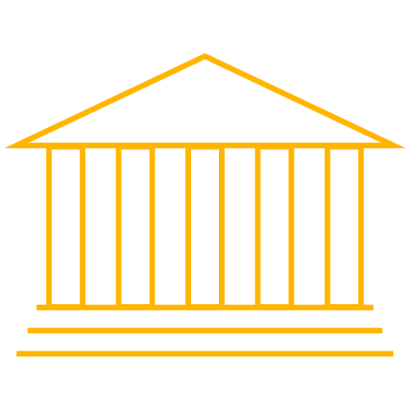
When You Catch a Phish
What to do when you suspect a message is phishing
Anywhere
Do not click interactive elements in the message
Do not reply to or forward the email
Do not click, open or download attached files
Do not follow the instructions in the message
Notify the purported sender using a new email or alternate method
When authenticity is not established, delete the message immediately
At Work
Follow your organization’s policy, which may include reporting it to your technical support team
At Home
Report the message to the purported sender and,
if possible, the email provider
Block the sender’s email address or phone number
Notes:
Suggested Script:
You may respond to a phishing or smishing attempt differently depending on where you receive the message, but you should always report it first, then delete it. Be sure to follow your organizational policies if you are at work and use best practices at home as well.
Following these best practices could prevent others from falling victim to the same attack, which could help thwart potential cyberattacks.

Slide 28
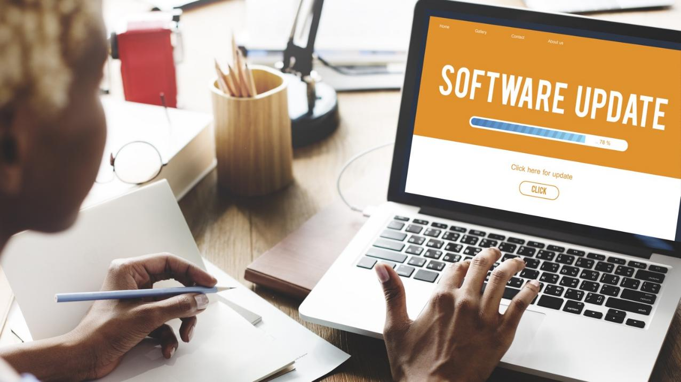
Updating Software
Key Behavior #4
Proprietary and CONFIDENTIAL. Do Not Distribute. © 2025 Optiv Security Inc. All Rights Reserved.
Notes:
Suggested Script:
In addition to credential theft and compromise, phishing and other social engineering tactics, threat actors also try to capitalize on vulnerabilities in software and applications. Developers do their best to patch or fix these vulnerabilities to safeguard their users and information from being exploited.

Slide 29

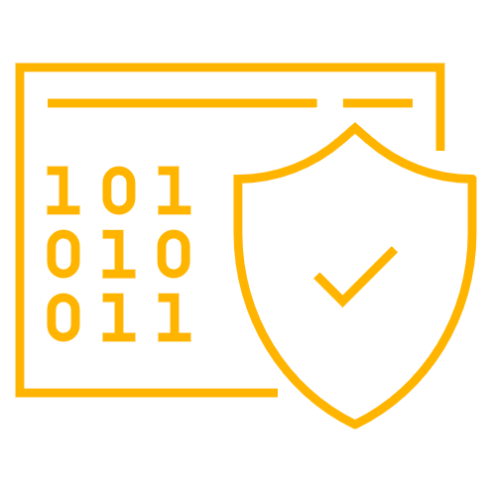


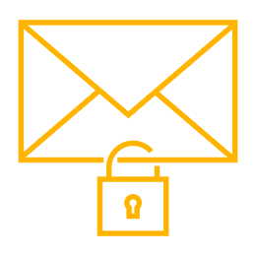
Automation: Enable automatic updates straight
from the source
Be suspicious of pop-up windows that urgently demand software updates via download
Avoid pirated and unlicensed software, as they often serve as a tool to spread malware
Do not click links in emails pushing for application, software or device updates; navigate directly to the source and check for updates
Proprietary and CONFIDENTIAL. Do Not Distribute. © 2025 Optiv Security Inc. All Rights Reserved.
Notes:
Suggested Script:
Security updates are released with relative frequency to keep up with the nefarious activities of threat actors. Instead of checking your settings daily for all the applications and software you use, consider turning on automatic updates. While you might have to restart your device to fully install the updates, the rest of the effort is done for you.
While automation can help prevent missed updates, there are other important considerations that should be made.
First, be suspicious of pop-up windows on your computer that demand urgent downloads to update software. This is often a social engineering tactic to exploit human emotion and feelings of urgency.
As a general good practice, avoid using pirated or unlicensed software, as these are often a front for malicious tools. Updating these will not address security vulnerabilities; in fact, installing updates may introduce additional risk to your device, data you’re processing or networks you’re connected to.
Alerts for updates that come via email are a known cover for phishing. Instead of clicking links or downloading attachments, navigate directly to the source and check for updates. The source may be the app store, an official website or a software update center on your device.

Slide 30
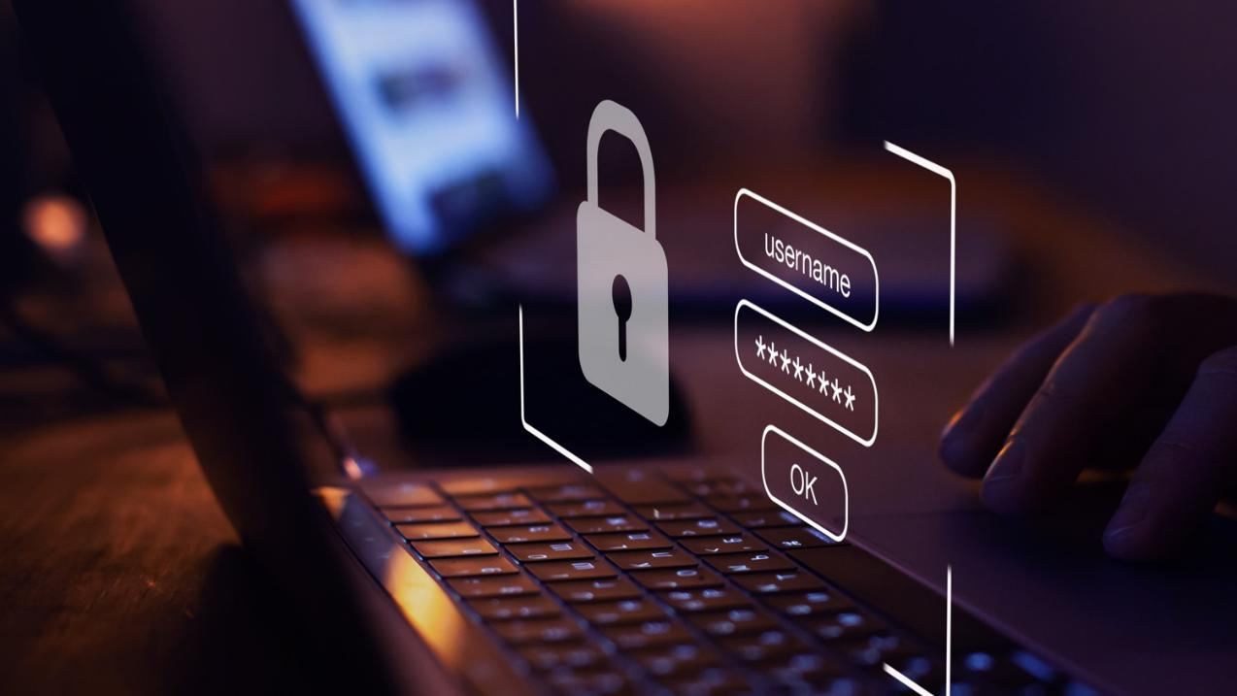
In Summary
Key Behavior
Proprietary and CONFIDENTIAL. Do Not Distribute. © 2025 Optiv Security Inc. All Rights Reserved.
Notes:
Suggested Script:
Cybersecurity isn’t a once-a-year task to check off your to-do list. It takes awareness with each click to stay safe online.

Slide 31

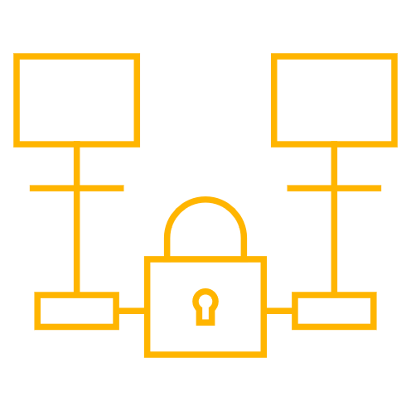
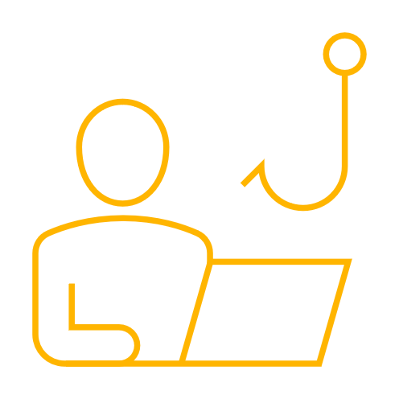


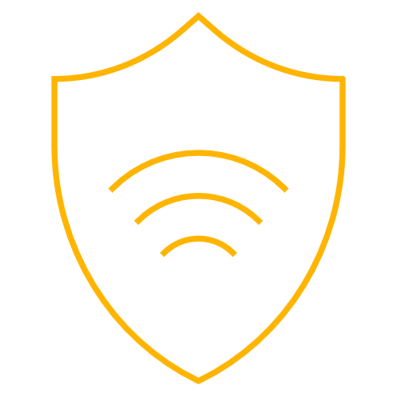
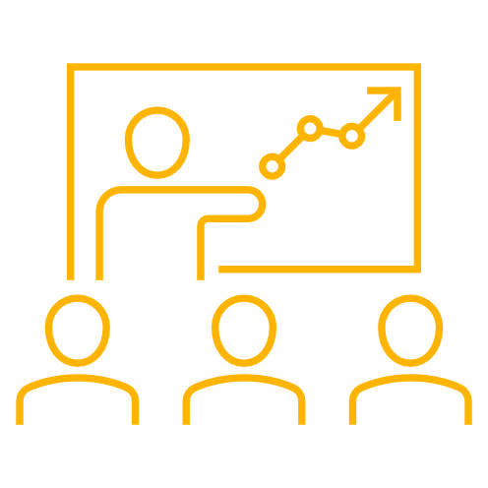
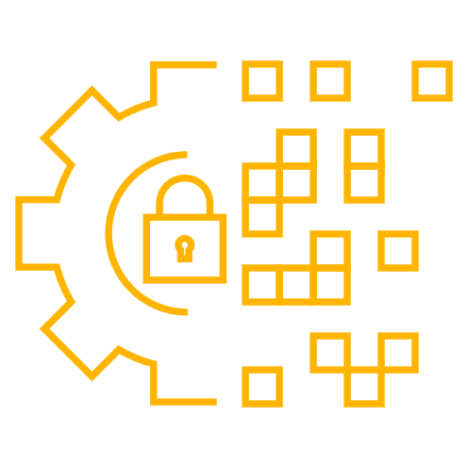


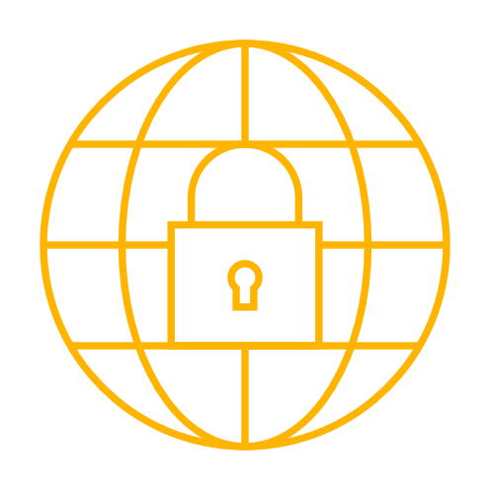
Key Cybersecurity Behaviors
To stay safe online, make these behaviors part of your regular routine.
Use Strong
Passwords
Enable
MFA
Recognize and
Report Phishing
Update
Software
Create
Backups
Use a
VPN
Learn From Security Awareness Training
Assess Your
Digital Hygiene
Share Cybersecurity Knowledge
Know Risks of Generative AI Tools
Avoid Using
Public Wi-Fi
For more tips to secure your data and business from cybersecurity threats, check out our resources:
https://www.optiv.com/cybersecurity-dictionary/phishing
https://www.optiv.com/insights/discover/blog/what-do-when-your-password-shared-compromised-or-breached
Notes:
Suggested Script:
We’ve discussed the importance of using strong passwords, enabling MFA, recognizing and reporting phishing and updating software regularly today. Your security also depends on:
conducting regular digital hygiene assessments to ensure your online presence is clean.
creating backups in case of data loss.
learning from security awareness training.
sharing your cybersecurity knowledge with coworkers, clients, family and friends.
avoiding connecting to public WiFi, when possible.
using a virtual private network (VPN) to shield your online activity from those who seek to use it for their benefit.
knowing the risks of inputting information into generative AI tools.
Engaging in these behaviors can help keep you safe online.

Slide 32
Thank you

